Slide 1
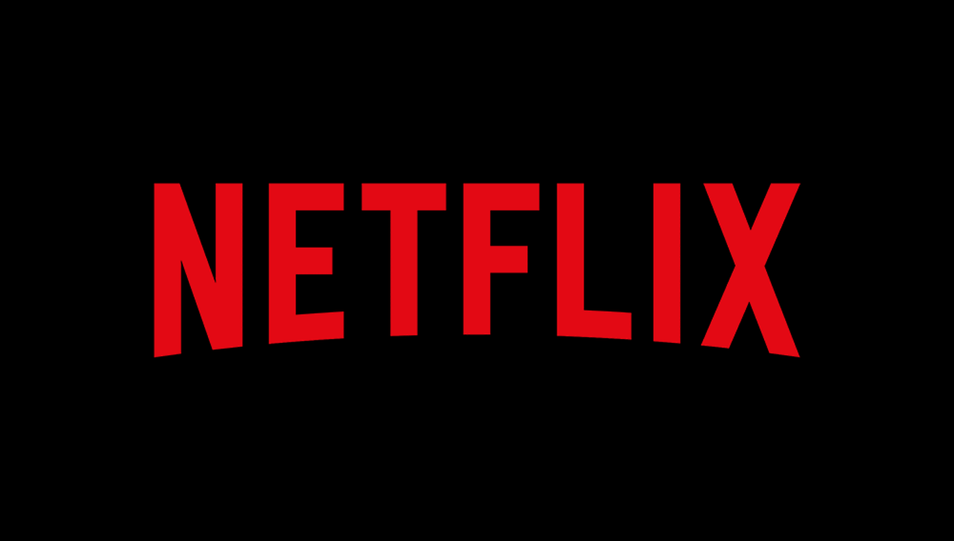

WHAT’S THE NEXT BIG THING?
SHWETA SAMPATH KUMAR

Slide 2
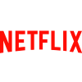
WHAT WILL WE COVER TODAY?
WHAT WORKED FOR NETFLIX?
JOURNEY SO FAR…..
WHY IS IT WORKING?
DEMOGRAPHICS
WHAT’S THE NEXT BIG THING?

Slide 3
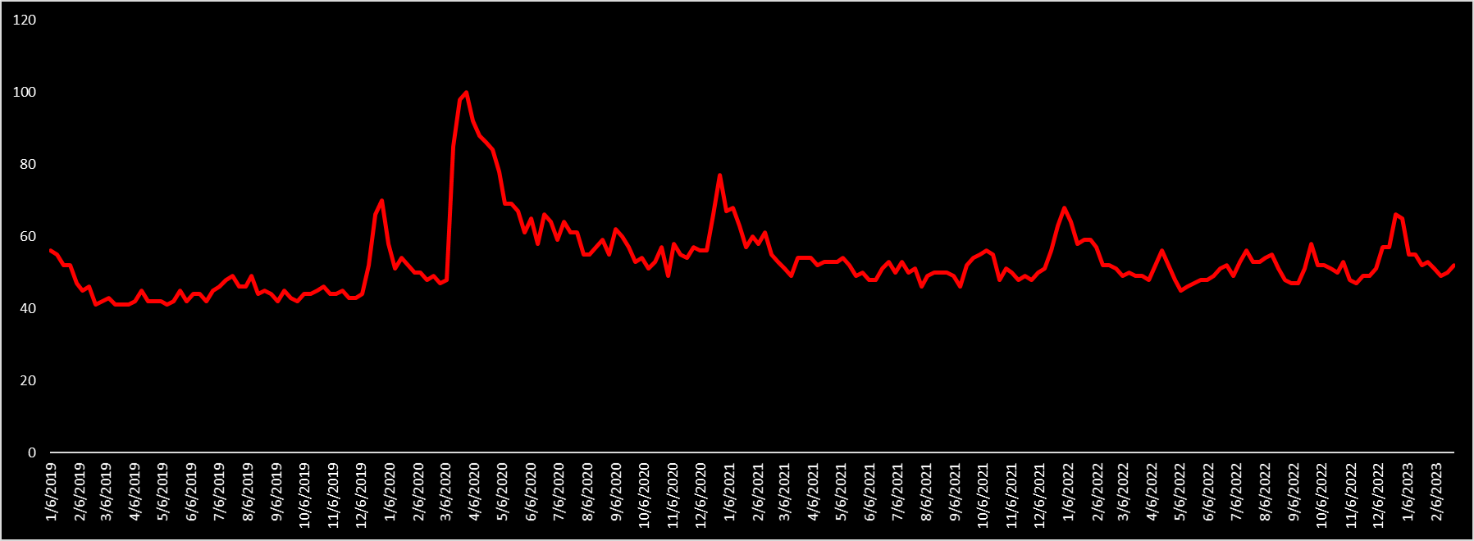
JOURNEY SO FAR…..
Source: Google Trends
Netflix has been doing pretty well over the past few years, but as seen above there’s been a big peak across 2020 and it has been having multiple increases till date. So what changed in 2020?

Slide 4
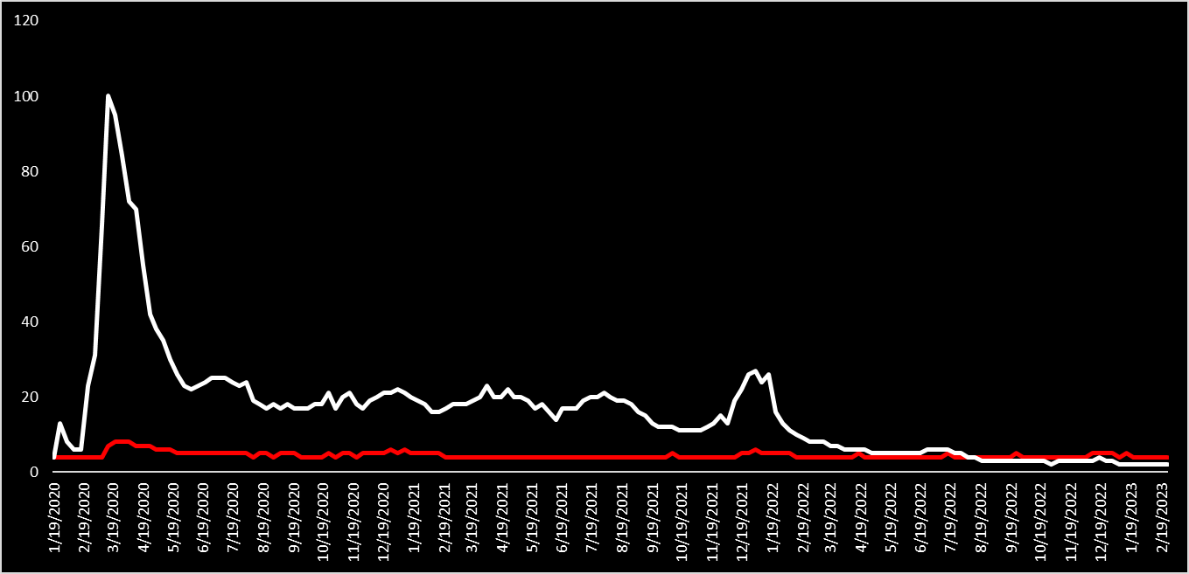
JOURNEY SO FAR…..
Source: Google Trends
COVID
NETFLIX
COVID happened! As COVID started spreading around March 2020, Netflix also has an increase in Google trends. COVID was a big reason for the change in consumer consumption.

Slide 5
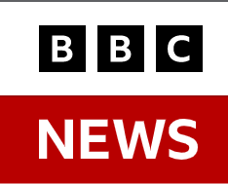
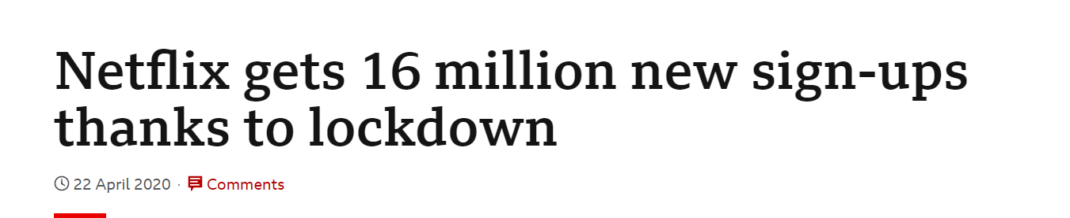
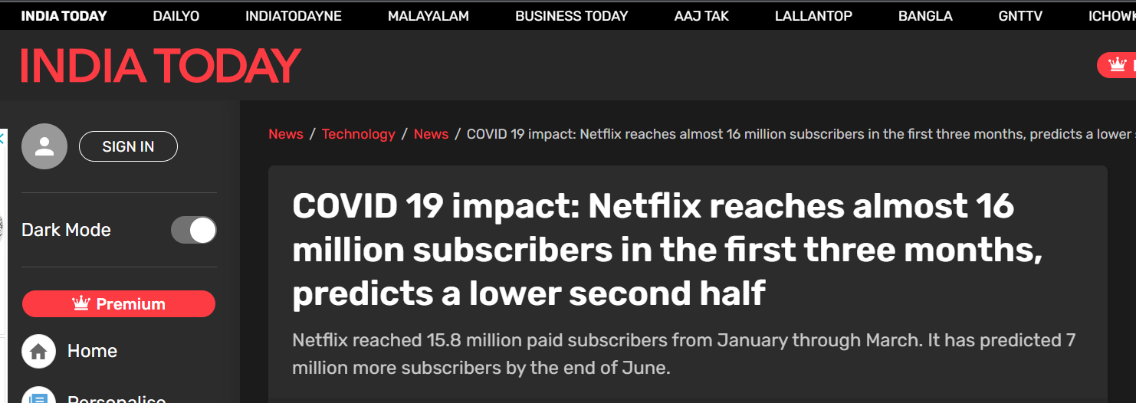
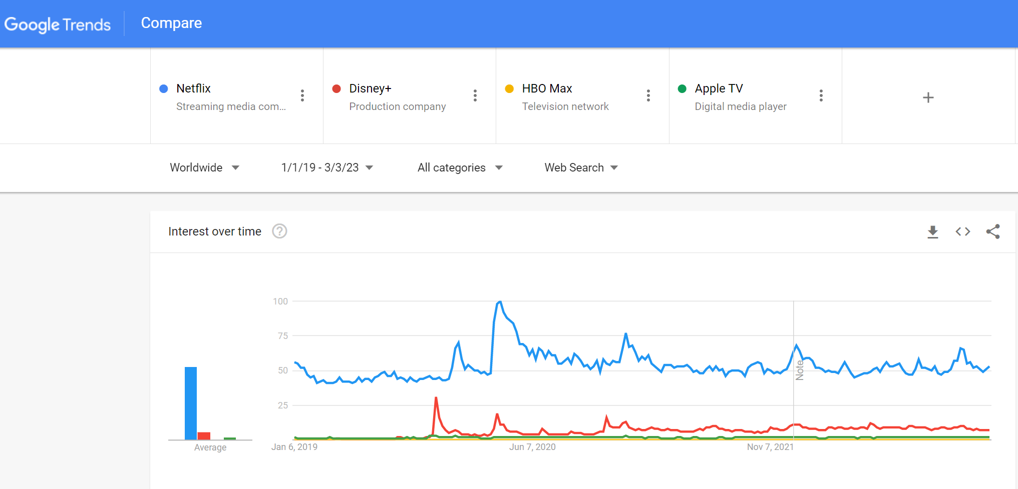
JOURNEY SO FAR…..
People flocked to digital streaming services for their entertainment and Netflix was one of the biggest players in the field.

Slide 6
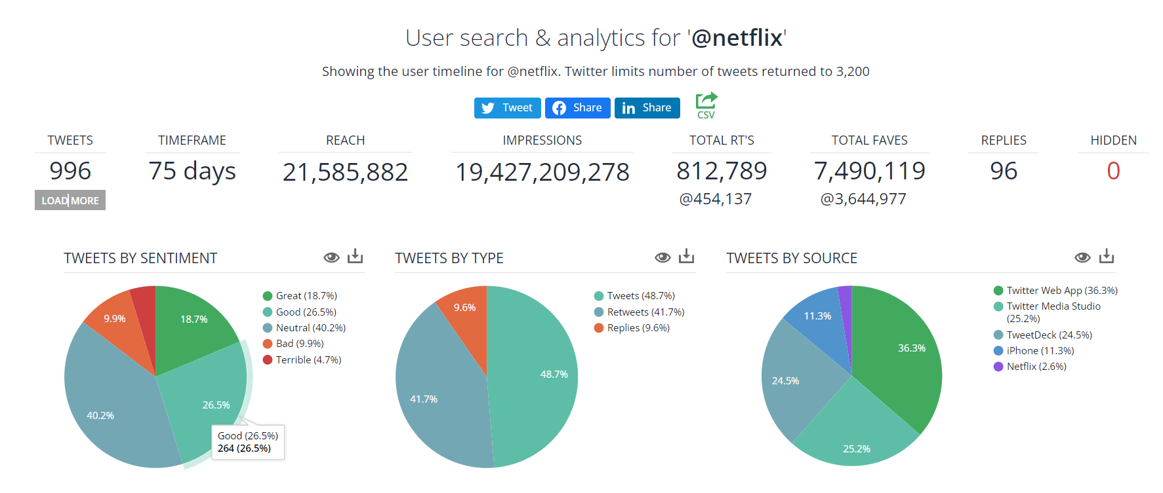
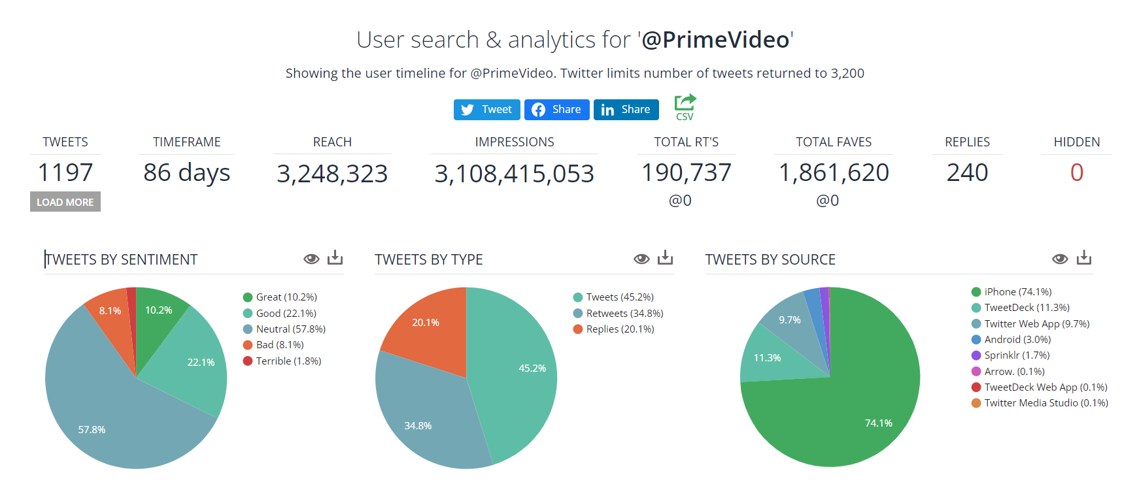
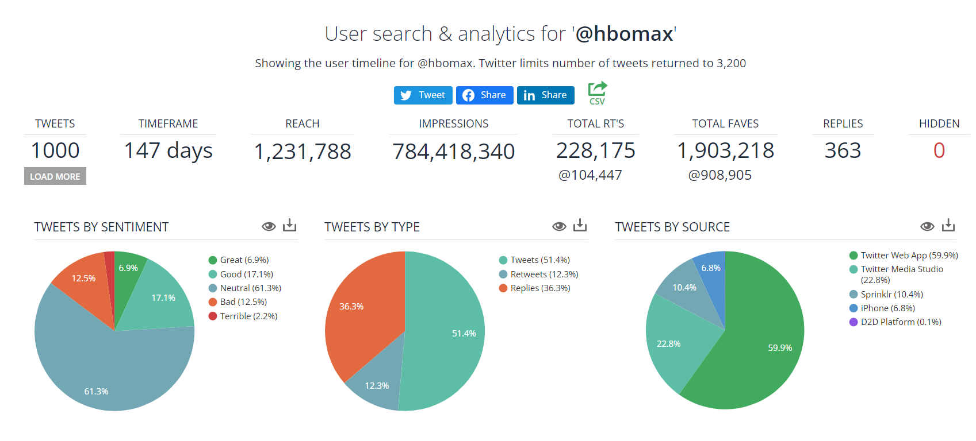
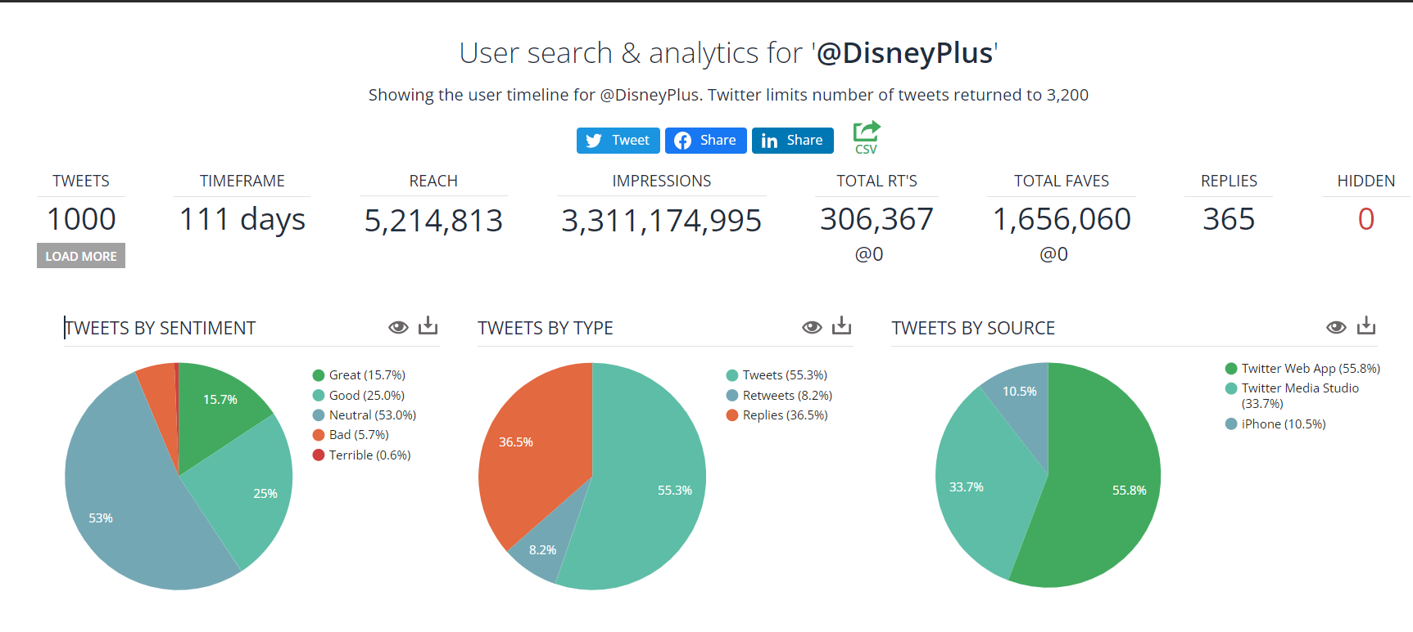
JOURNEY SO FAR…..
Netflix currently has the highest reach and impressions with an overall positive sentiment across Twitter compared to its competitors.
Source: SocialBearing

Slide 7
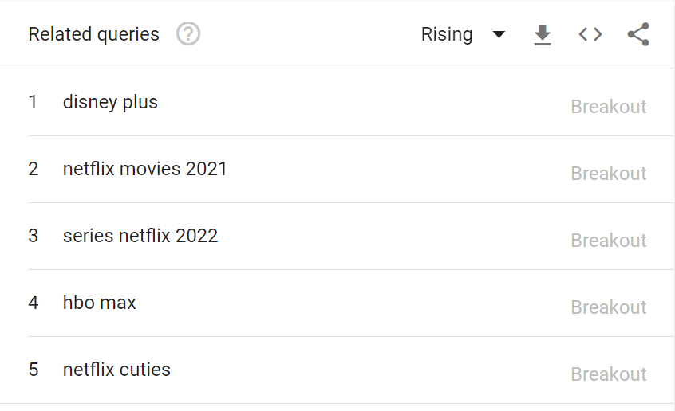
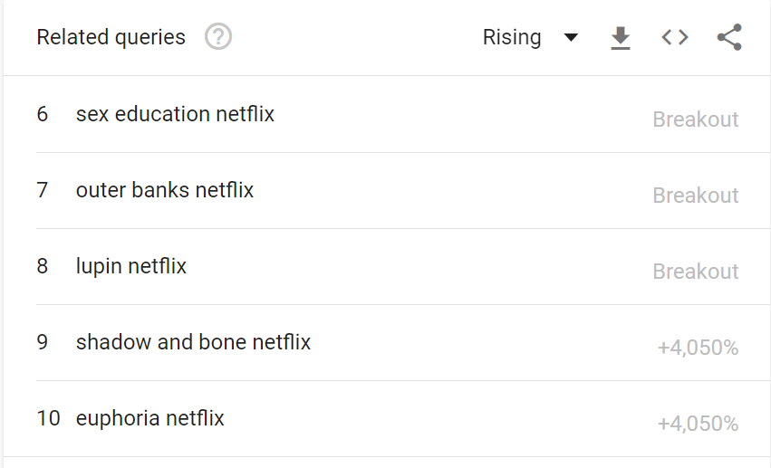




JOURNEY SO FAR…..
Based on Google Trends, from 2019 till date, when comparing with Netflix’s competitors, Netflix and it’s content has been in the top trending topics and has also seen a breakout for these search terms.

Slide 8








JOURNEY SO FAR…..
According to IMDB, based on a calculated QScore (average ratings * number of votes) for those which did have the information available, these are Netflix’s highest rated and popular content.
QScore = 4055656.8
QScore = 3696320
QScore = 1963134
QScore = 3940754.4
QScore = 2504275.2
As can be seen, Netflix’s TV shows are their best performers.
QScore = 3093160.2
QScore = 2006623.7
QScore = 2316631.2

Slide 9
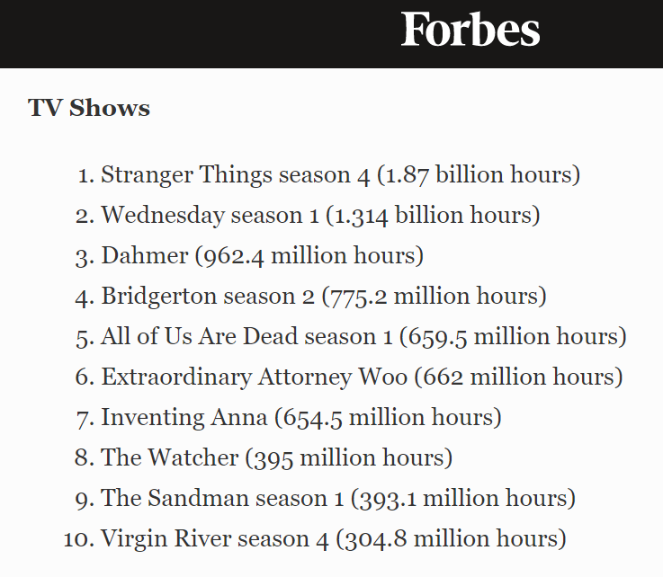
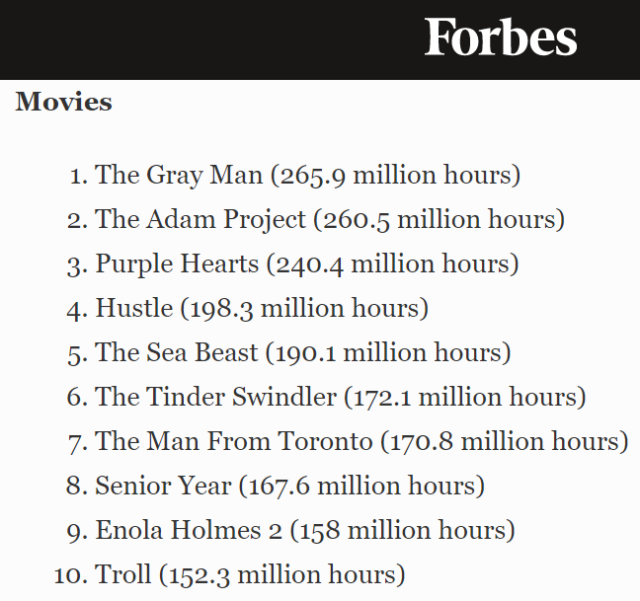
WHAT WORKED FOR NETFLIX?
According to Forbes for 2022, based on viewership hours, Netflix’s best TV shows and Movies are:
Source: https://www.forbes.com/sites/paultassi/2022/12/30/netflix-reveals-its-top-10-shows-and-movies-of-2022/?sh=2325ecf7859f

Slide 10
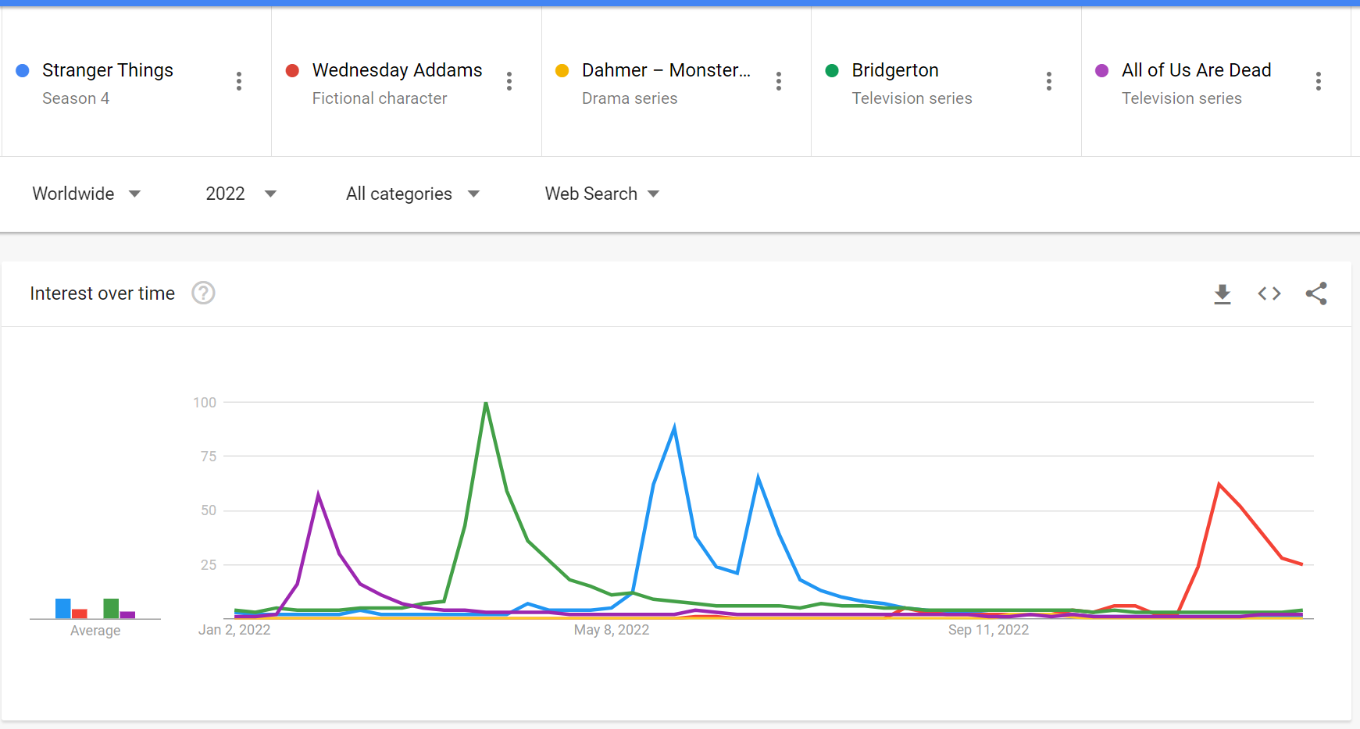
WHAT WORKED FOR NETFLIX?
The trend does seem to show even in Google Trends for these top 5 shows. The popularity for these peaked when they
were released especially Stranger Things which maintained a high popularity for months.
The above shows consists of book adaptations (Bridgerton), language adaptations (K-Dramas), nostalgia adaptations (Wednesday, Stranger Things) and real-life events (Dahmer).

Slide 11
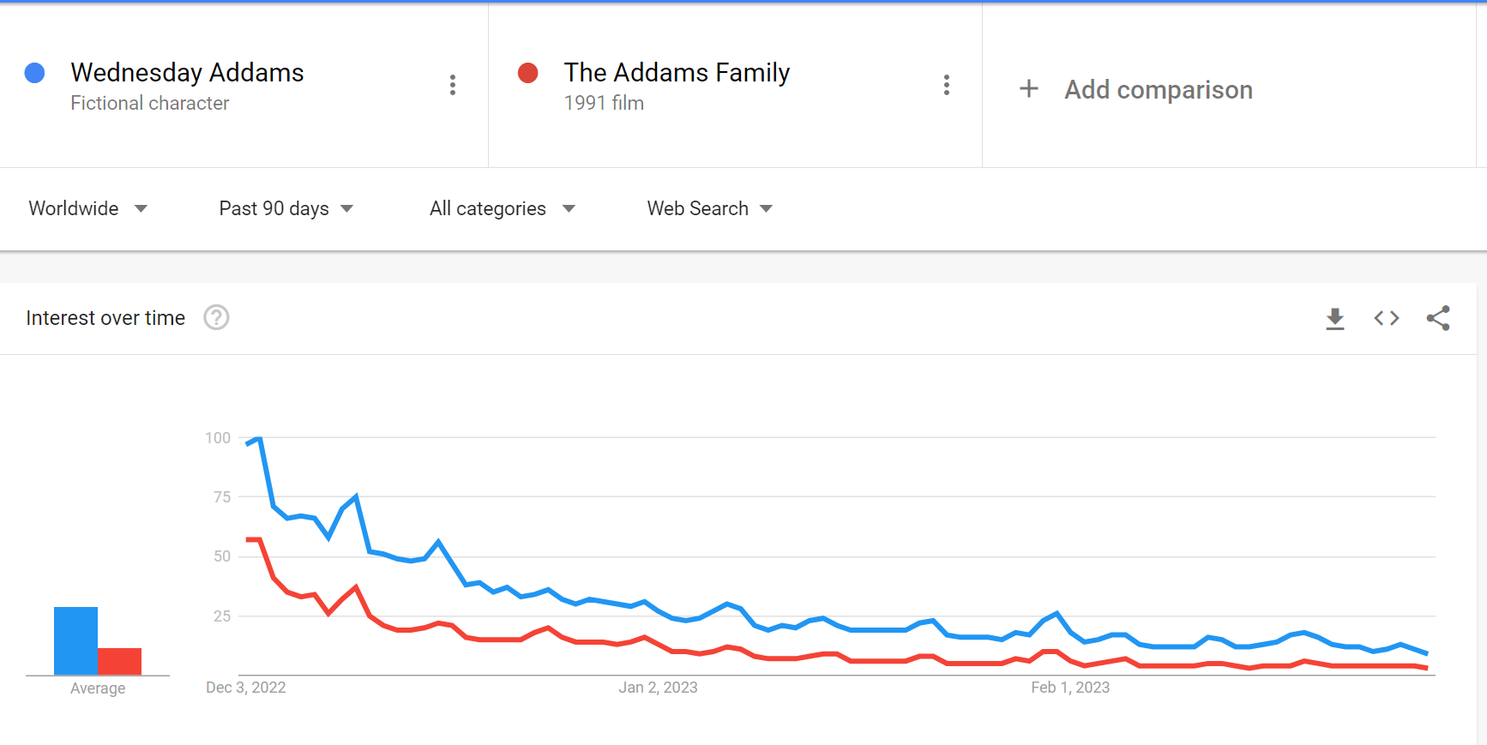
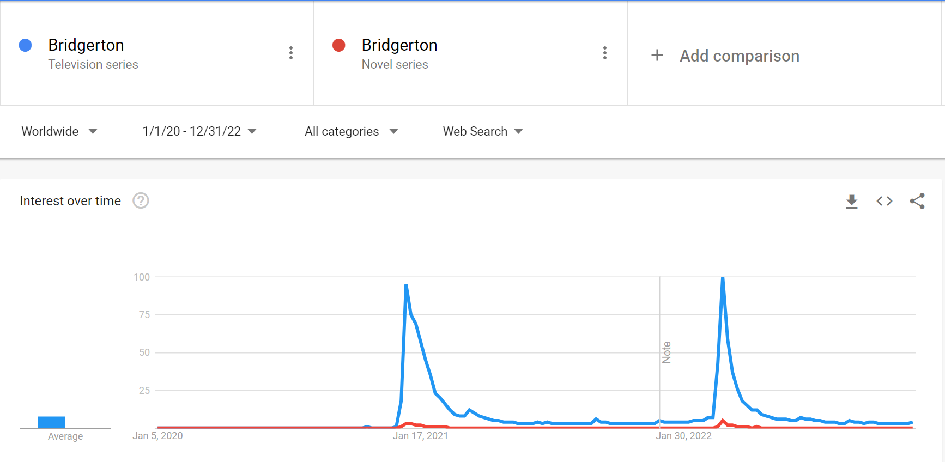
WHAT WORKED FOR NETFLIX?
In the case of Wednesday, it worked majorly because of the nostalgia factor it brought with regards to a well loved movie and cartoon series – The Addams Family as seen below from the Google Trends, they had a very similar trend line.
Bridgerton, which is an adaptation of the Bridgerton Novel series also had a similar trend line on Google Trends.
Source: Google Trends

Slide 12
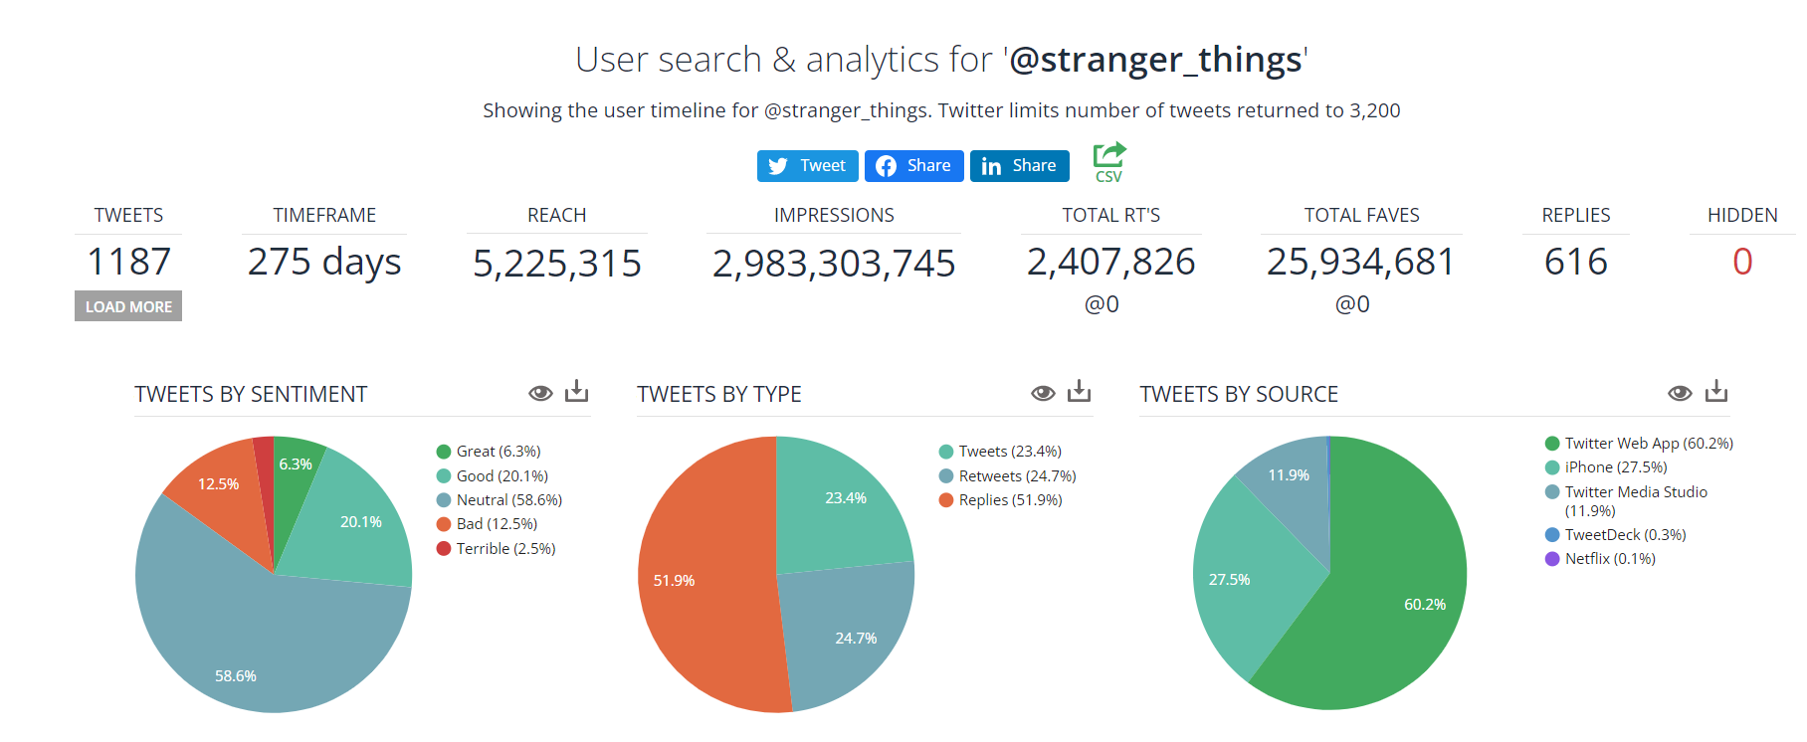
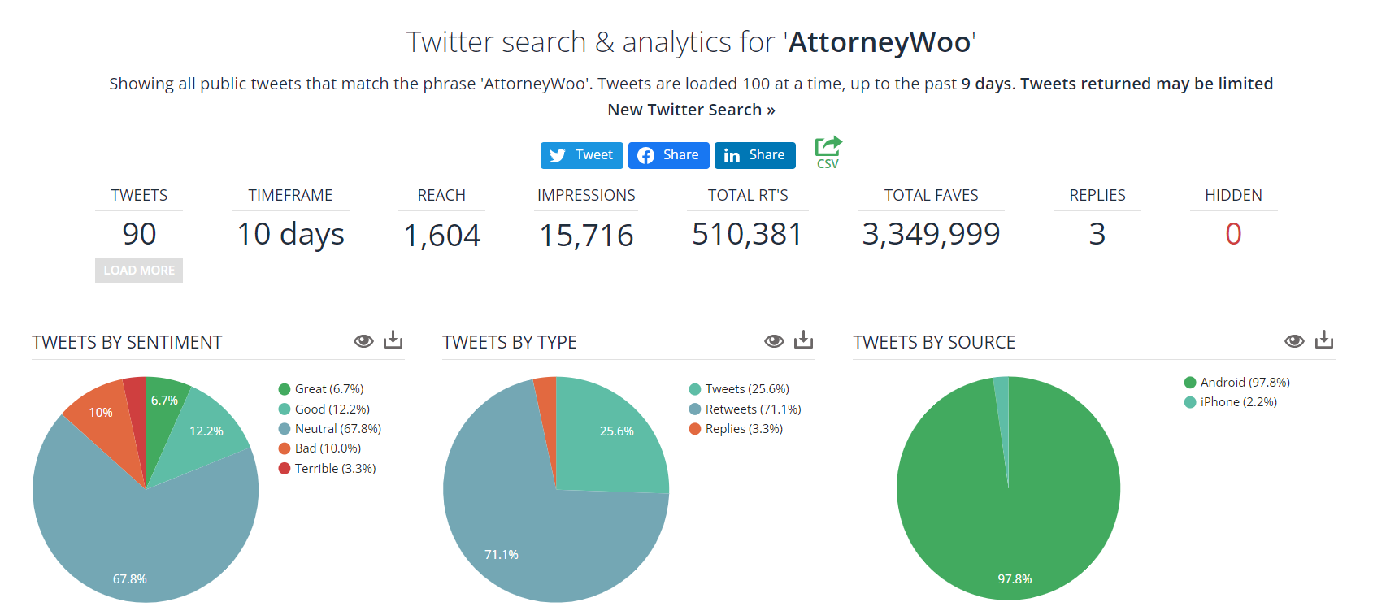
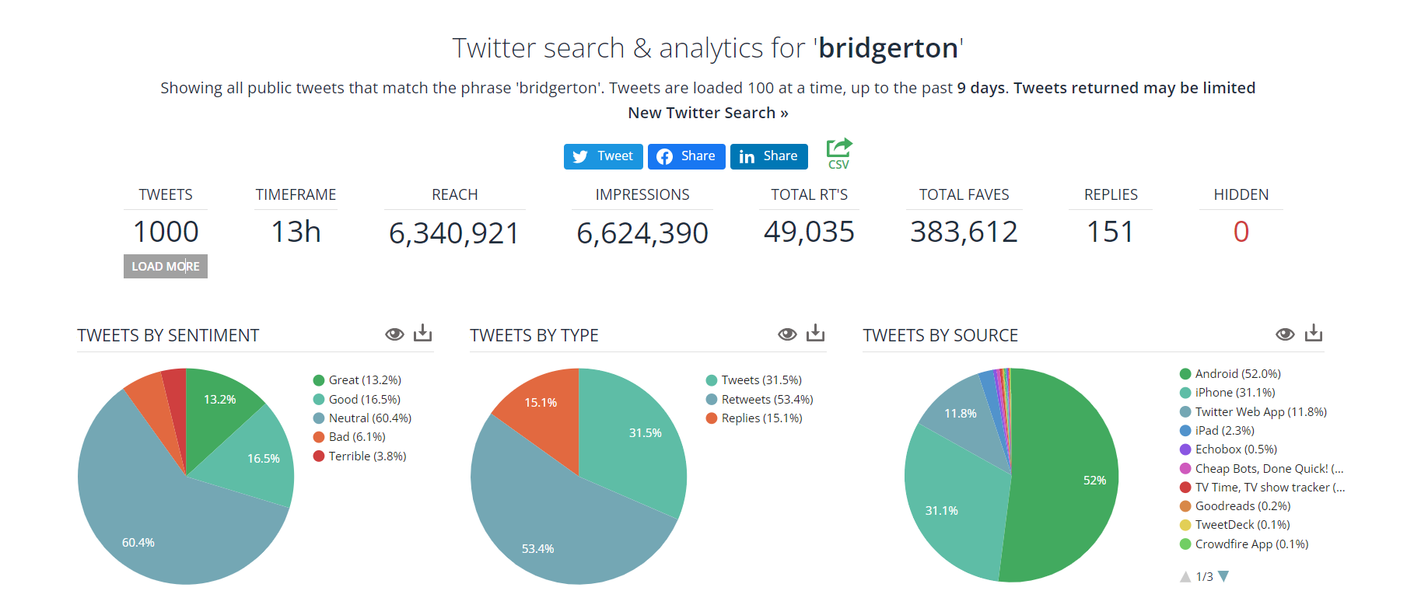
WHAT WORKED FOR NETFLIX?
Even across Twitter, the sentiment for these shows have overall been good or neutral.
Source: SocialBearing

Slide 13
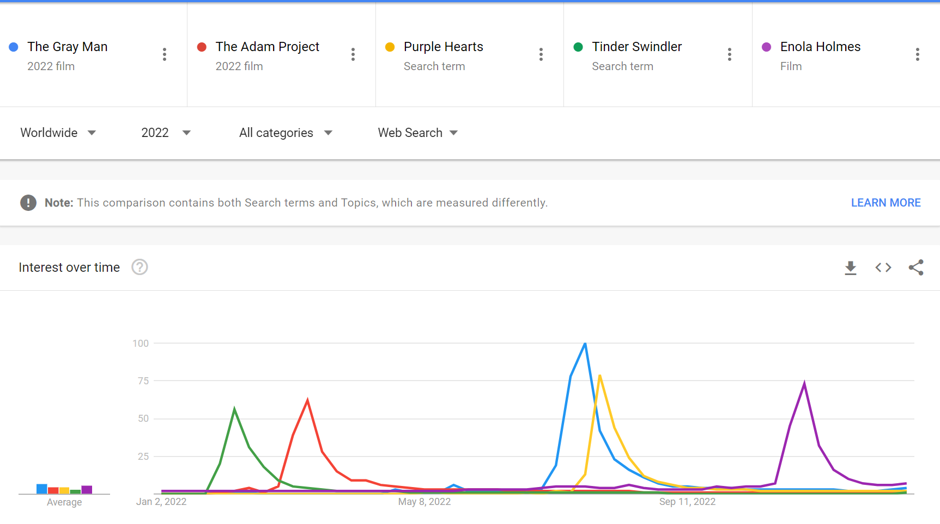
WHAT WORKED FOR NETFLIX?
Similarly, the movies saw a similar trend where their popularity peaked when released.
Source: Google Trends

Slide 14
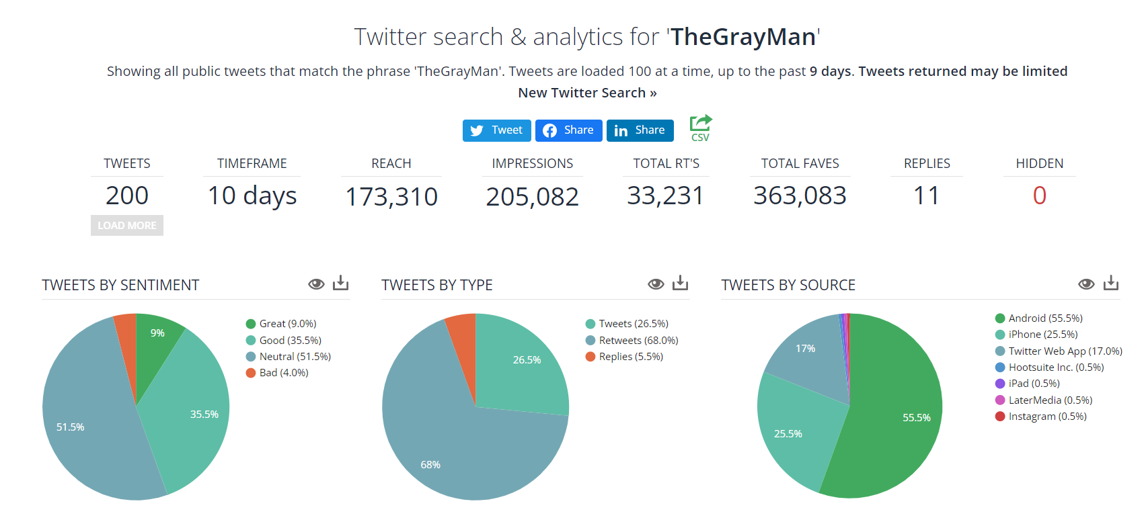
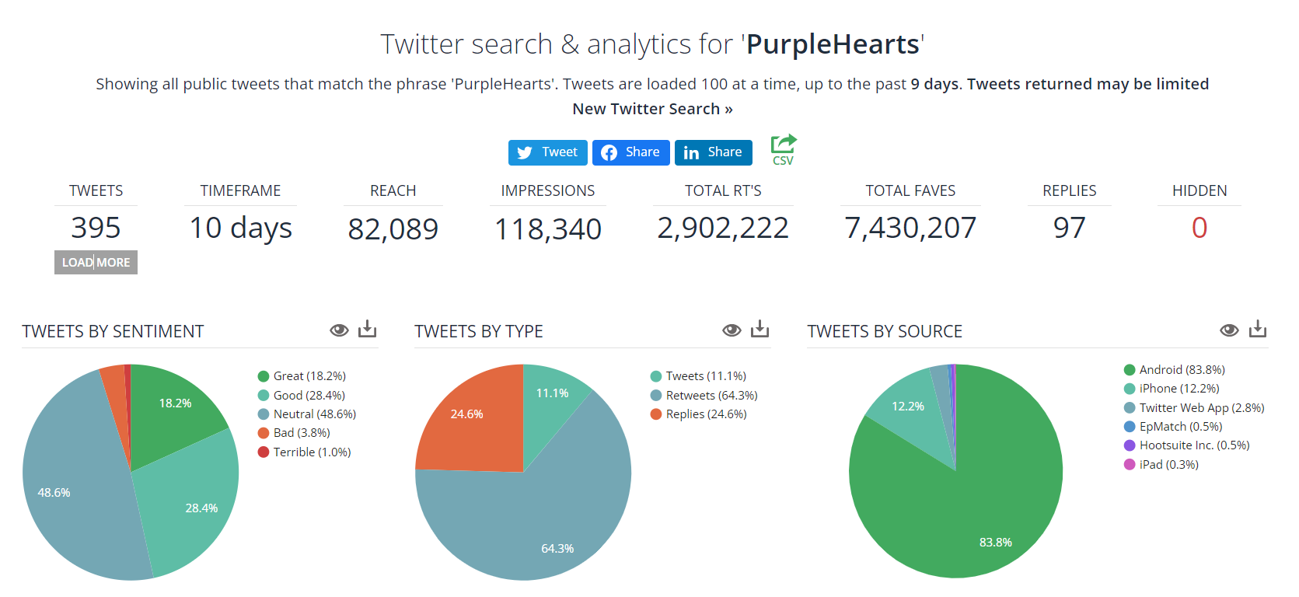
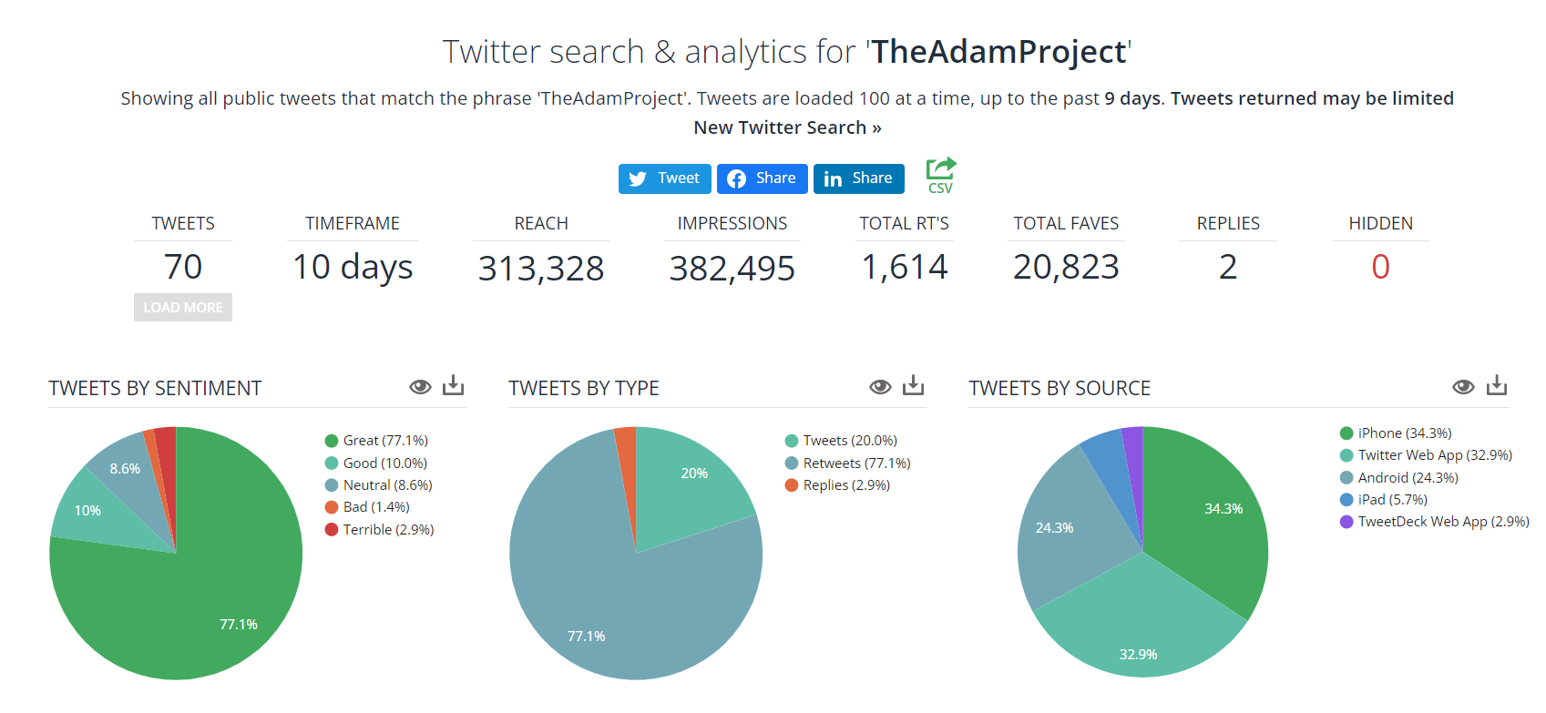
WHAT WORKED FOR NETFLIX?
The overall sentiment for some of these movies was also good and neutral, especially for The Adam Project which was very well received.
Source: SocialBearing

Slide 15
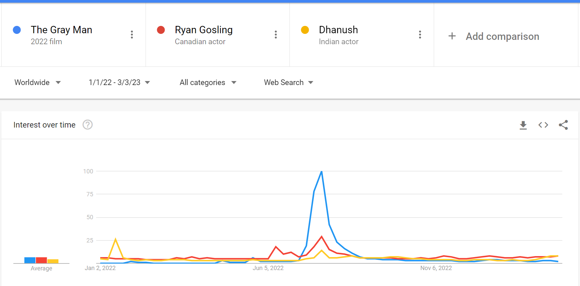
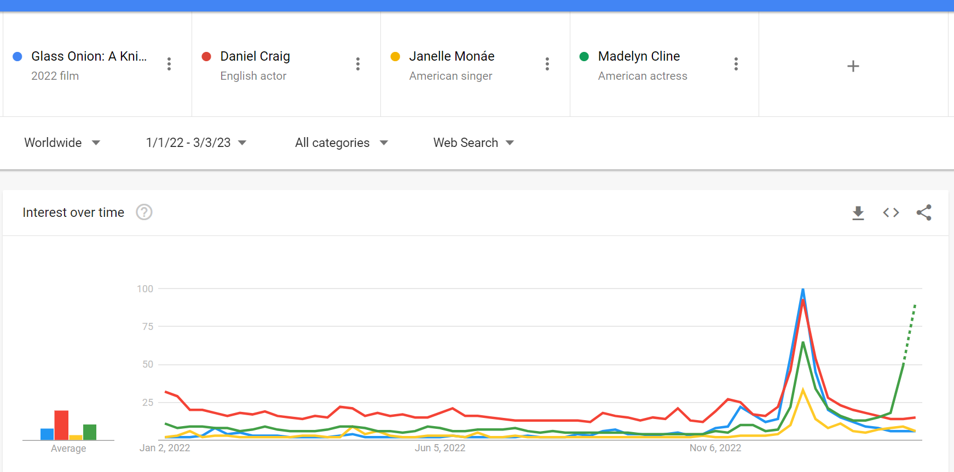
WHAT WORKED FOR NETFLIX?
A stellar cast for the movies The Gray Man and Glass Onion – Knives Out worked in their favor as the audience was eager to see popular actors from various favorite franchises share the same screen space. For example, Madelyne Cline from OuterBanks (Netflix TV show – slide 7) was one of the most popular searches for Knives Out.
Source: Google Trends

Slide 16
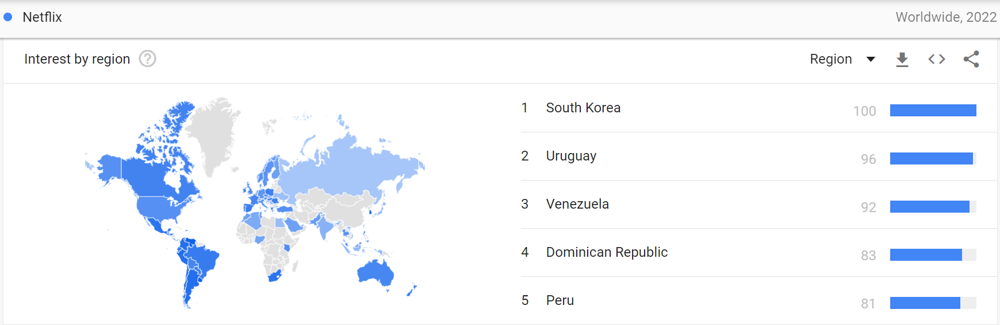
WHERE IS NETFLIX POPULAR?
Source: Google Trends
As seen from above, South Korea has the highest interest for Netflix in 2022. This is also evident from the two K-dramas (All of Us Are Dead & Extraordinary Attorney Woo) which are amongst the top 10 shows for Netflix according to Forbes.

Slide 17
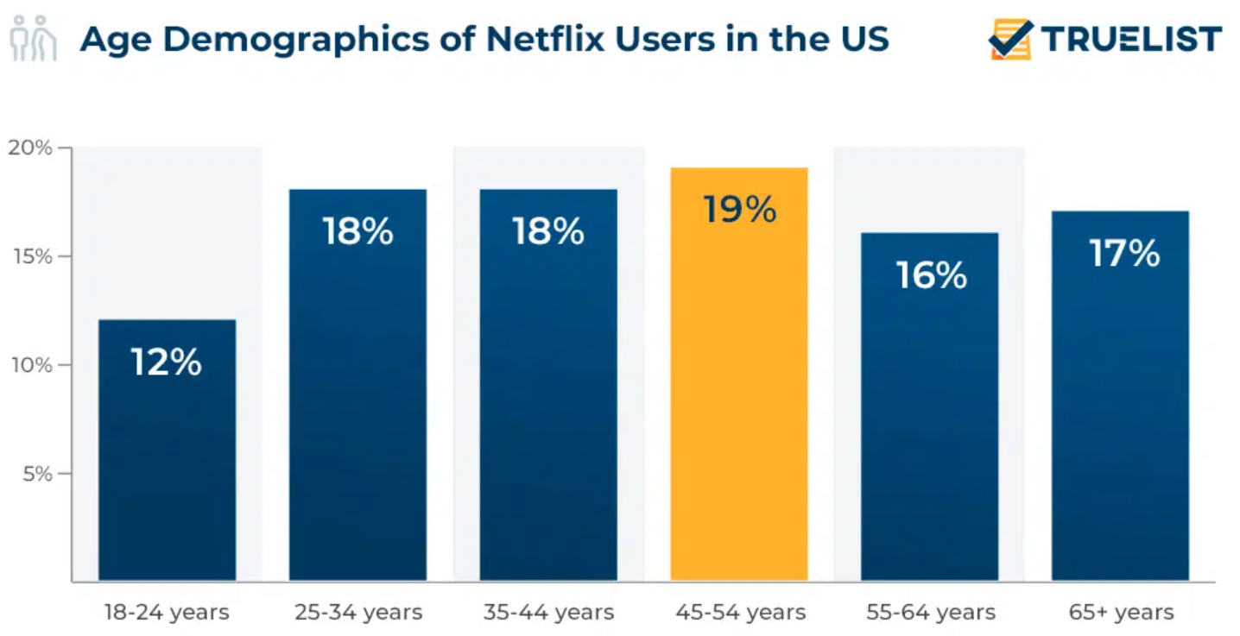
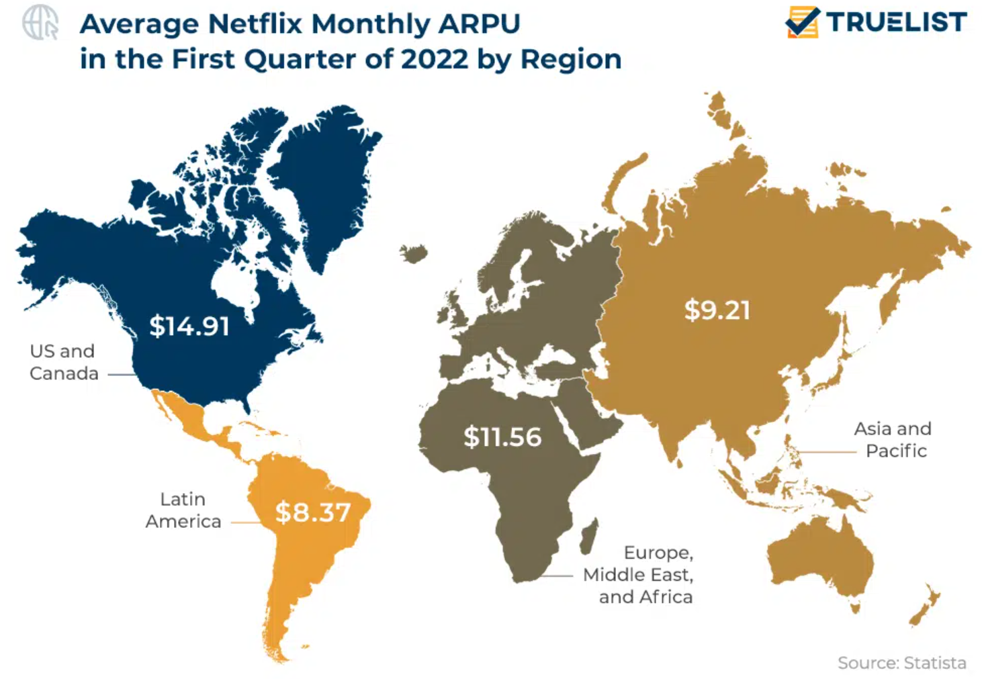
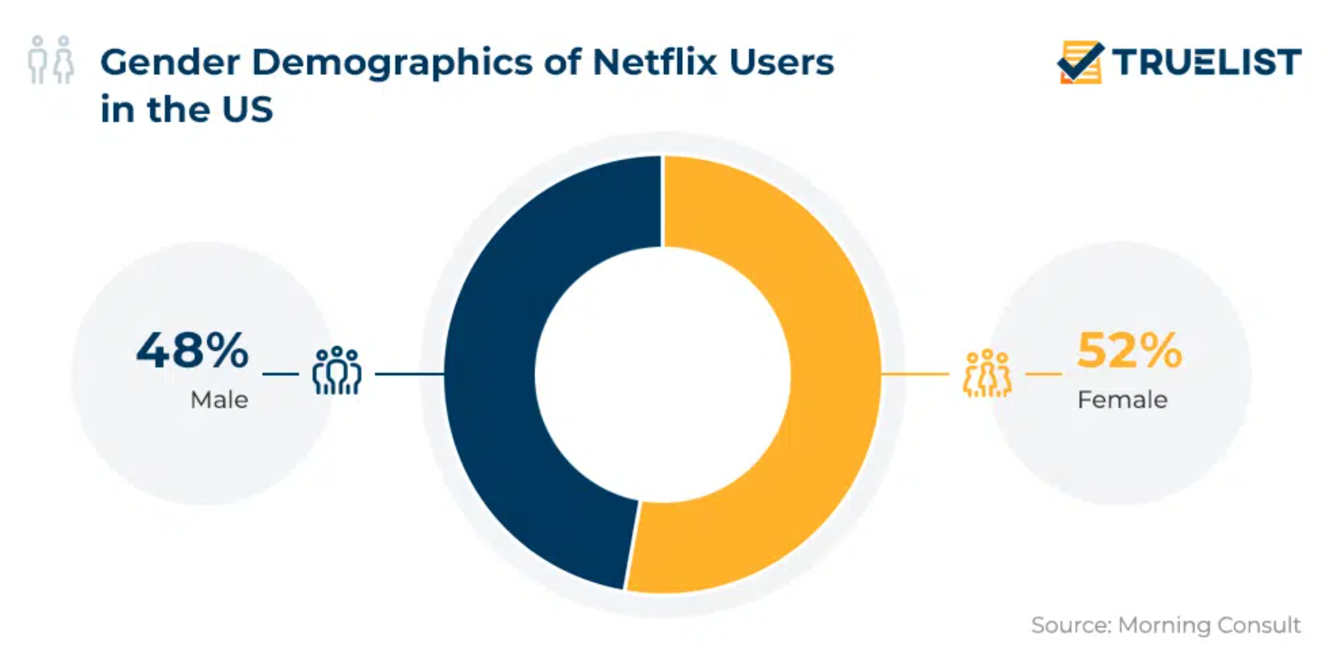
DEMOGRAPHICS OF NETFLIX
Netflix is popular amongst millennials, and is almost equal for both men and women.
Source: https://truelist.co/blog/netflix-statistics/

Slide 18
WHY IS IT WORKING FOR NETFLIX?
Netflix offers content in over 60 languages.
Netflix accounts for 17 percent of all worldwide online video subscriptions.
Gen Z prefers watching on-demand via OTT services than live TV.
The gender gap between Netflix viewers is almost non-existent.
47% of Americans preferred Netflix over any other platform in 2021.
Around 80 percent of Netflix users take the streaming service’s title recommendations offered by its algorithm.
Netflix has over 17,000 titles globally as of October 2022.
Netflix was the first true international streaming service of its kind
Source: https://www.comparitech.com/blog/vpn-privacy/netflix-statistics-facts-figures/

Slide 19
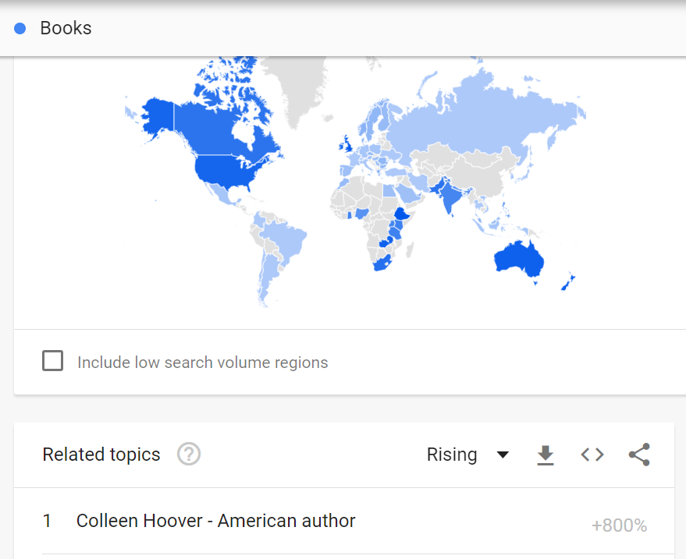
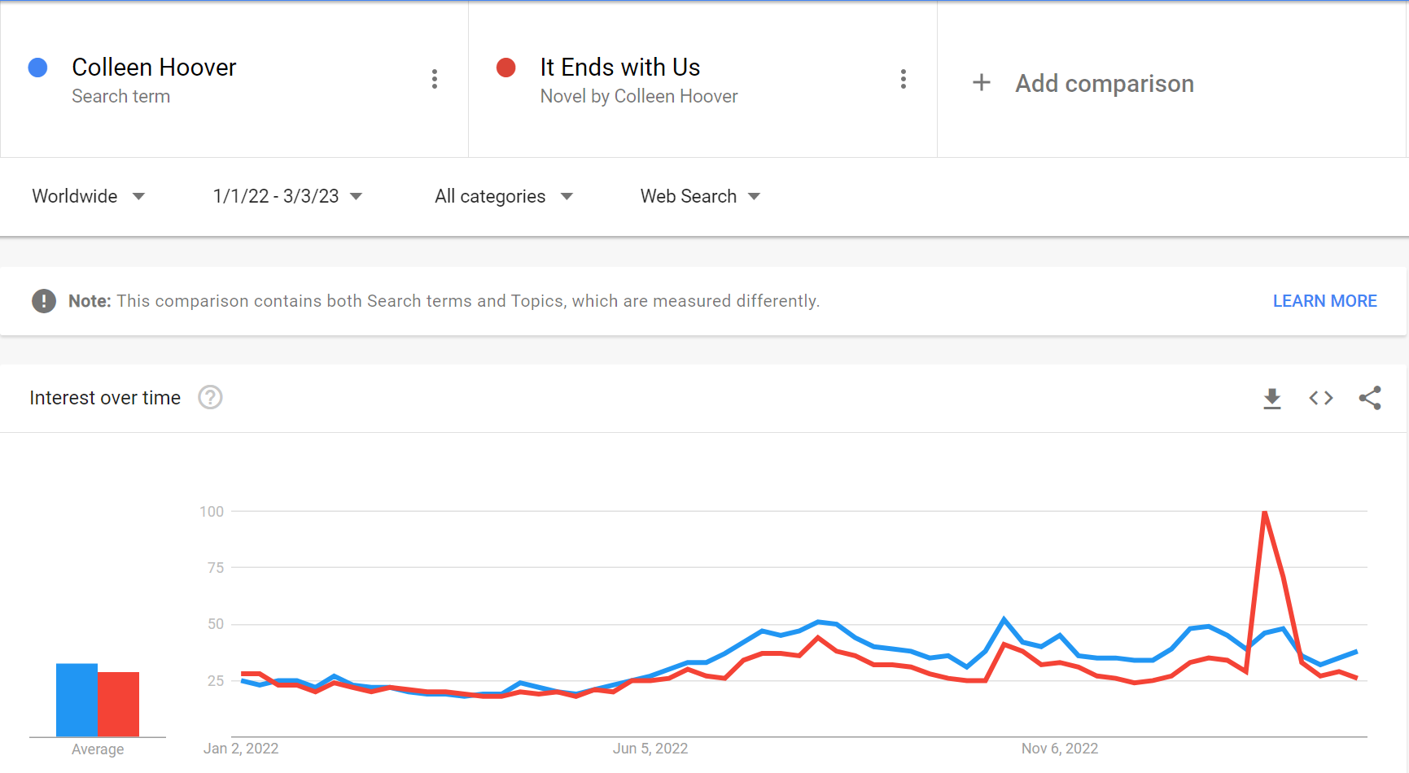

WHAT’S THE NEXT BIG THING?
Based on the previous data and trends seen, I would make the following recommendations which Netflix has been a leader at:
1. Book Adaptations –to begin with a Colleen Hoover book adaption as the first related topic to Books is hers. It would work well the female subscribers who are Netflix’s majority.
Source: Google Trends

Slide 20
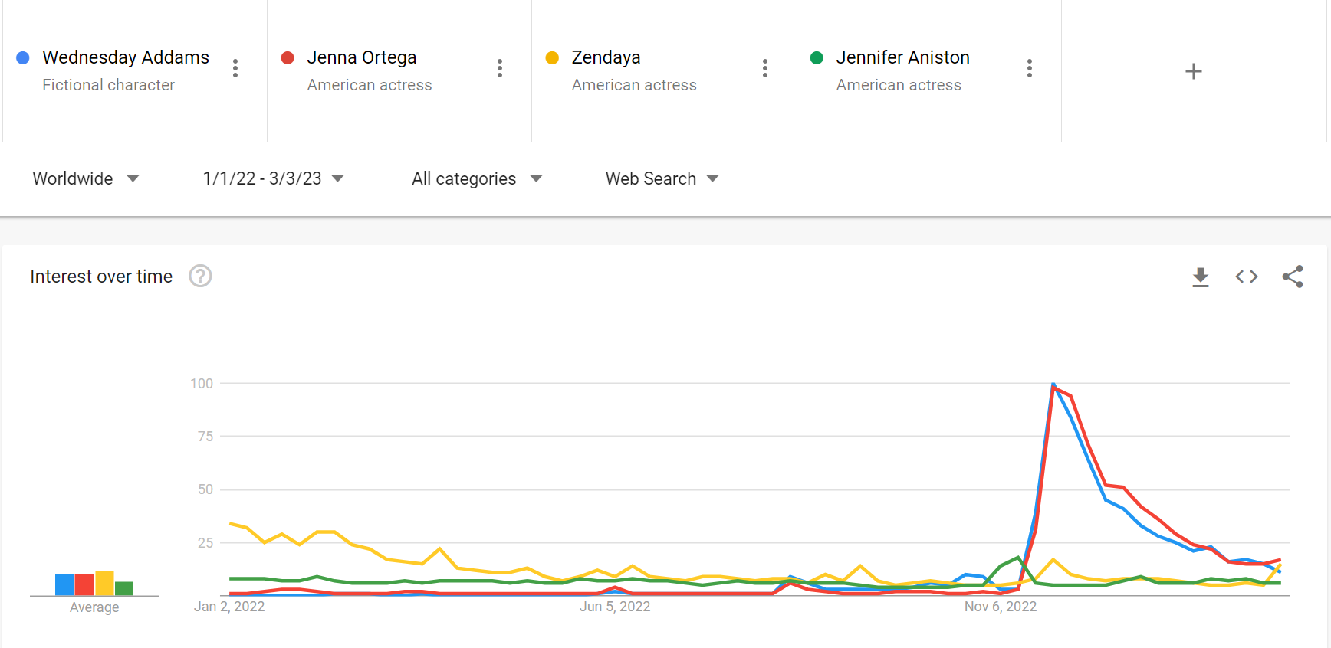

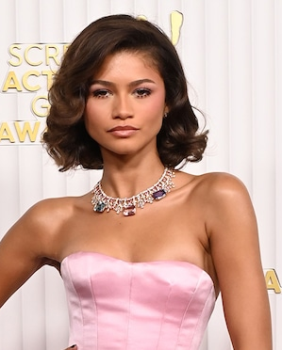
WHAT’S THE NEXT BIG THING?
Based on the previous data and trends seen, I would make the following recommendations which Netflix has been a leader at:
2. Project like movie or TV show with favorite actor over the past year for the audience – Jenna Ortega who played Wednesday Addams – probably share screen space with another popular actress like Zendaya. Similar to Knives Out Series for a stellar cast from different works of entertainment.
Source: Google Trends

Slide 21
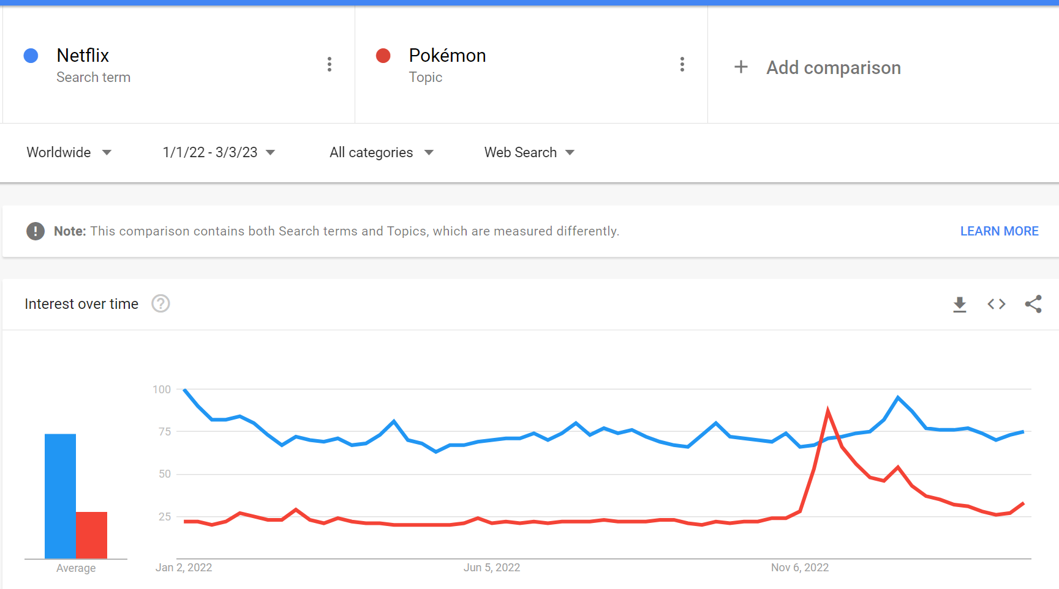

WHAT’S THE NEXT BIG THING?
Based on the previous data and trends seen, I would make the following recommendations which Netflix has been a leader at:
3. A video game adaptation that also tugs on nostalgia like a Pokemon series.
Source: Google Trends

Slide 22
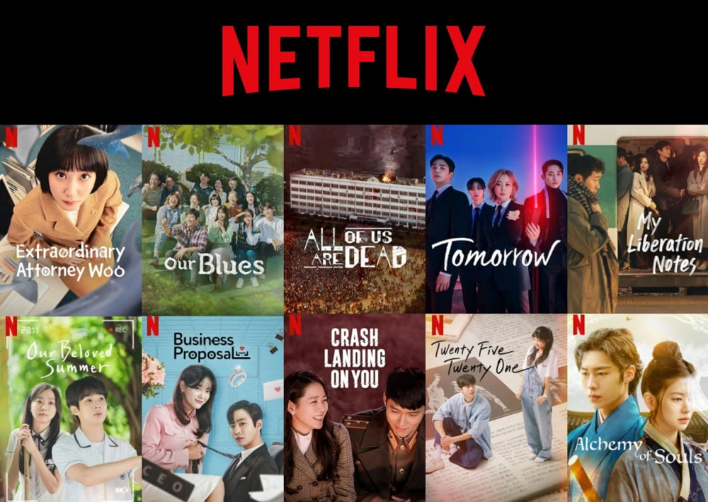
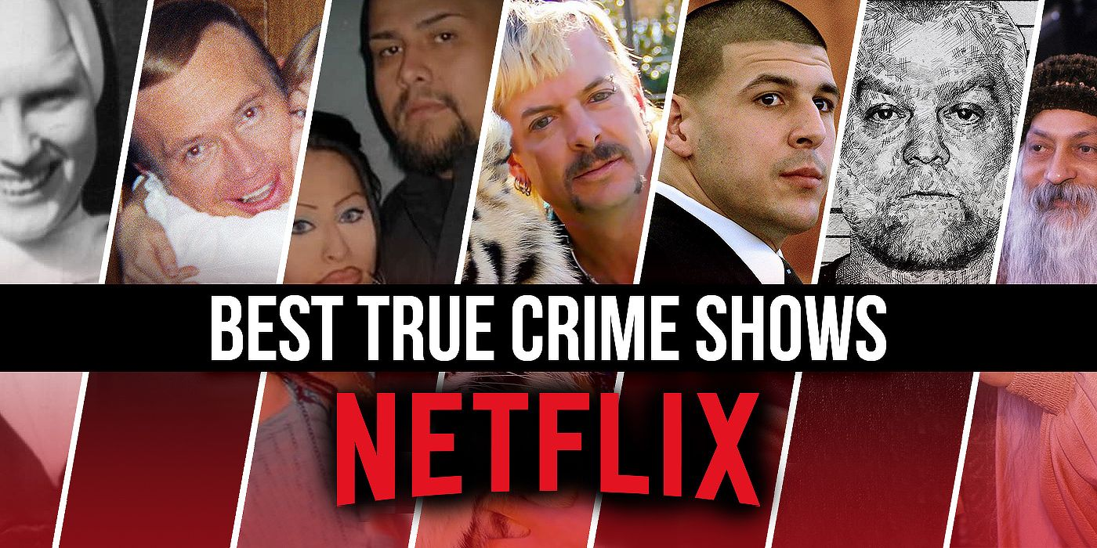
WHAT’S THE NEXT BIG THING?
Based on the previous data and trends seen, I would make the following recommendations which Netflix has been a leader at:
4. True Crime Documentaries & Series (Dahmer, Tinder Swindler are key examples of this success)
5. K- Dramas (With Netflix having their highest popularity in South Korea and 2 K-dramas in its top 10 list of most watched hours, this is an are to definitely invest in)

Slide 23
THANK YOU

